Slide 1
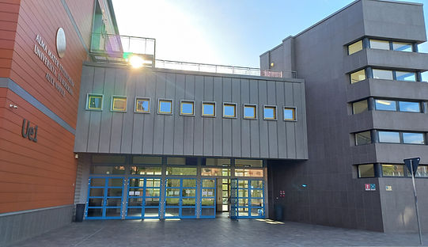
Venue: University of Bologna
Polo Navile - UE1 building
Via della Beverara 123/1,
40131 Bologna
Entry
link to UE1 in google maps

Slide 2
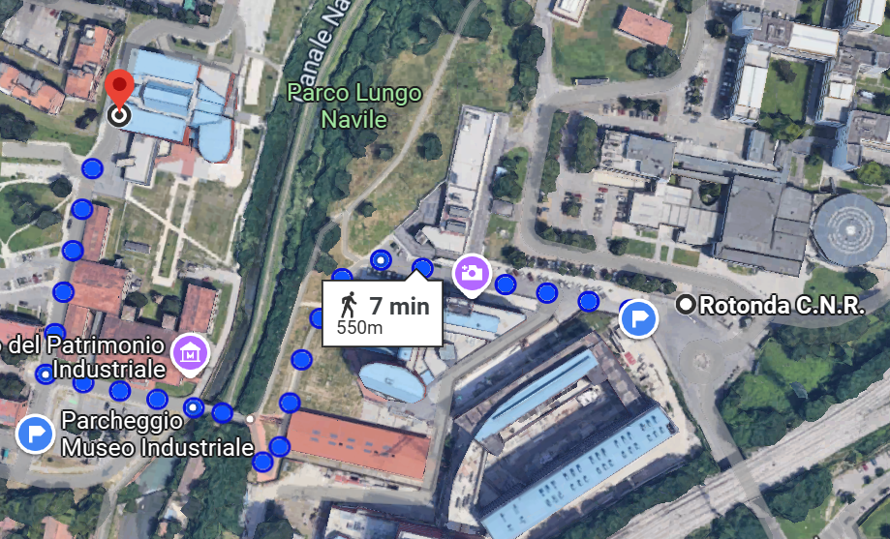
How to get there by bus
From the bus stop "Rotonda C.N.R." to the UE1 building
UE1 lecture room
bus stop:
Rotonda C.N.R.
Cafeteria
bridge on the Navile canal

Slide 3
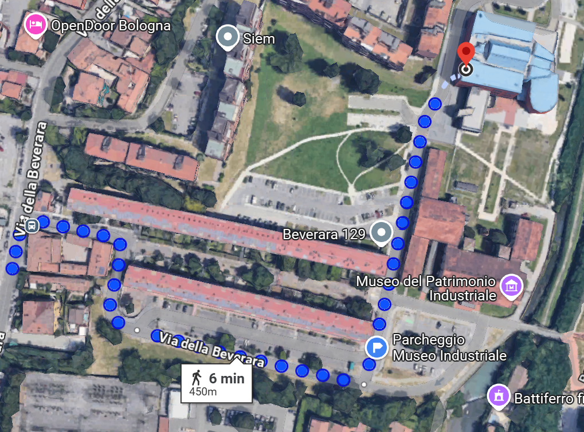
How to get there by bus
From the bus stop "Beverara" to the UE1 building
UE1 - lecture room
bus stop:
Beverara

Slide 4
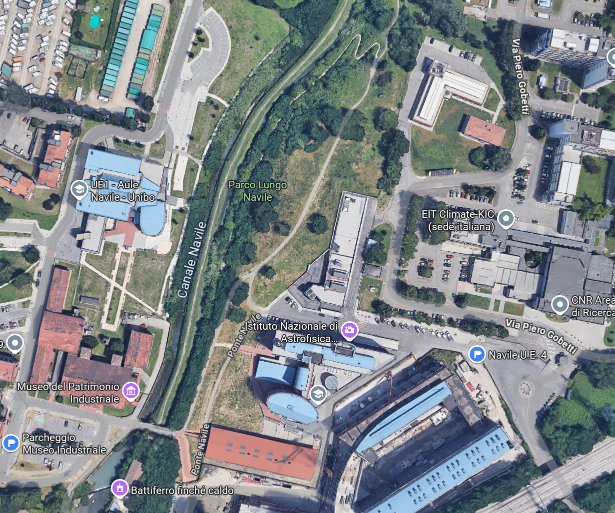
Driving? Here is where you can park your car:

Slide 5
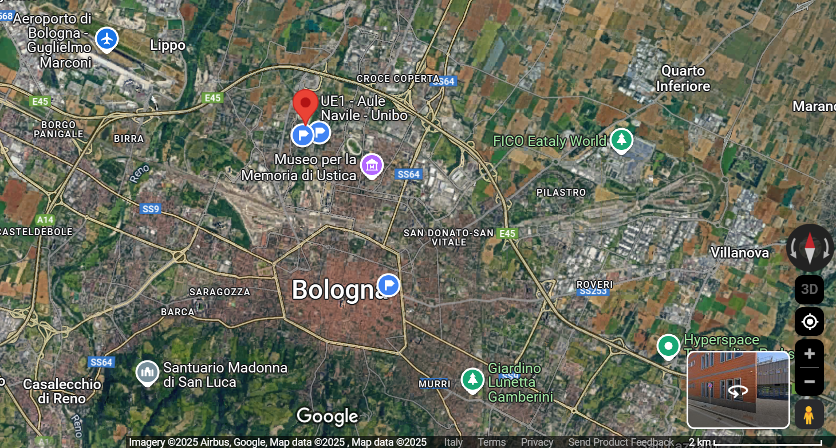
Airport "Guglielmo Marconi" (BLQ)
U.E.1
(lecture room)
Railway station (Bologna Centrale)

Slide 6
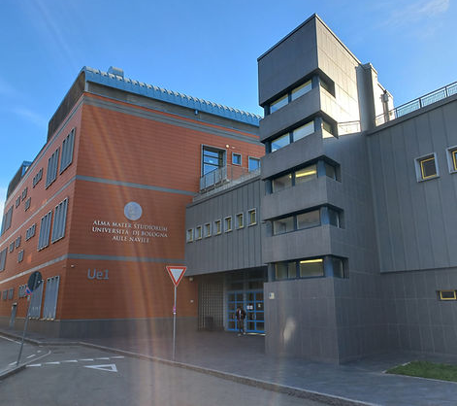
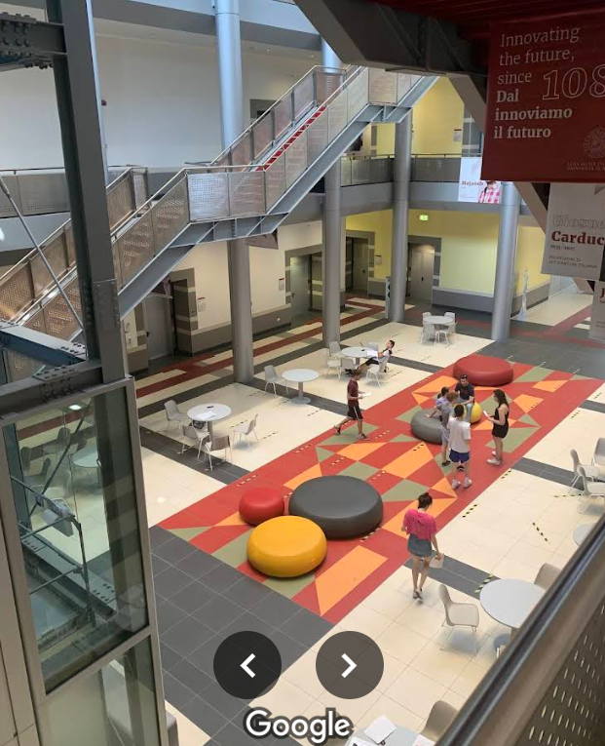
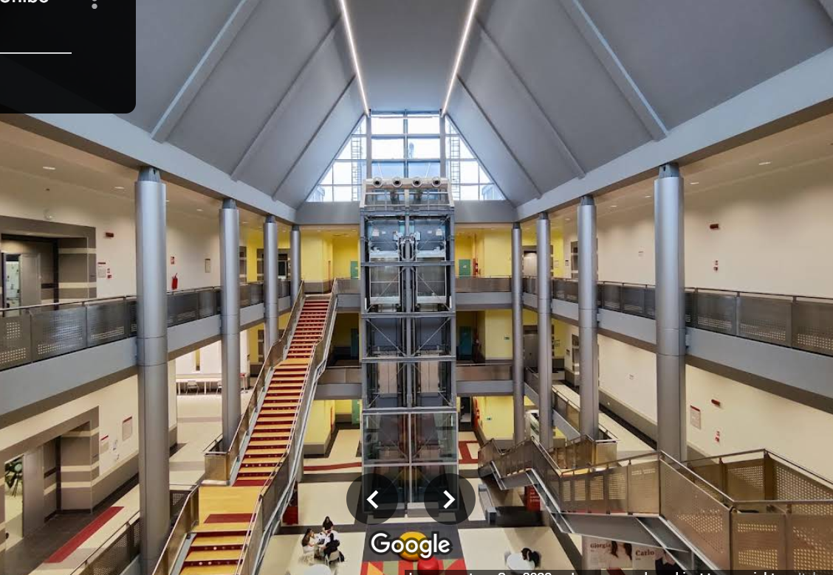
The U.E.1 building

Slide 7
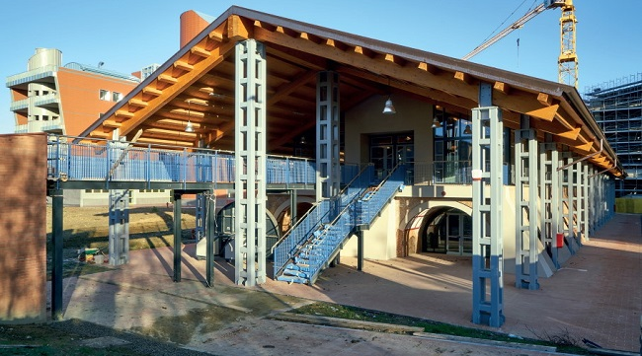
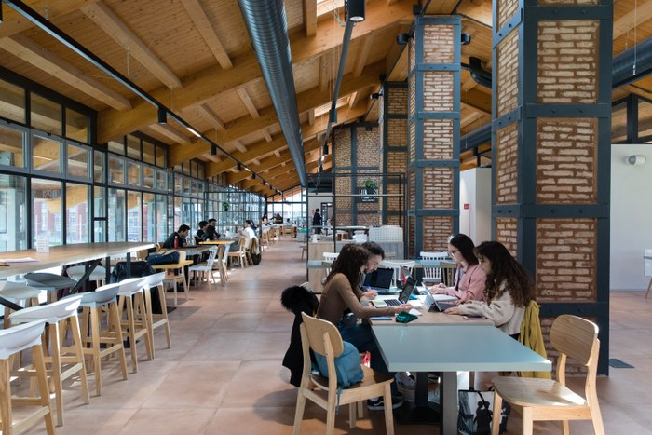
The CAFETERIA

